Slide 1

ActivPal Week #6
Matthew Turkenburg Adnan Akbas Colin Werkhoven Ali Safdari Mark Boon Dmitrijs Sekijevskis

Slide 2
Table of contents
What have we done previous week?
Current issues we are facing
What are the goals for the remainder of this sprint?

Slide 3
What have we done previous week?
Creating features for our model
Pearson correlation matrix
New insights
Data pre-processing
Trained our first model

Slide 4
Creating features for our model
Why?
The features
Standard deviation acceleration (vertical)
Average acceleration direction of the body (vertical)
Peak-to-peak

Slide 5
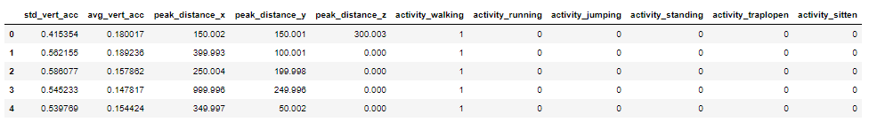
Features dataset
Dataset details
Segmented activities in 6.4S
Denormalized Dataset
More info in dia 9
Features
Peak-to-peak distance for X, Y and Z axis
Standard deviation of Z axis
Mean of Z axis

Slide 6
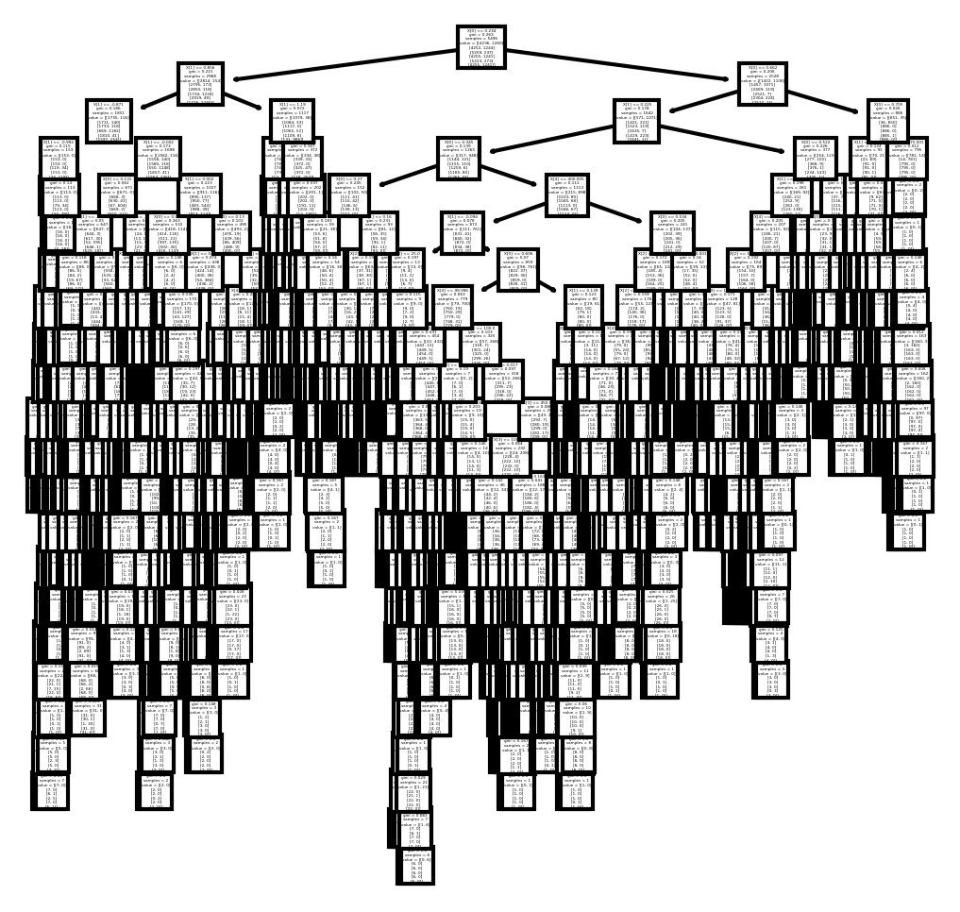
First run decision tree model results
Splitted dataset in train en test
Test size 20%
Stratified on labels
Model configurations
None
Metrics (rounded)
Accuracy: 0.73
Precision: 0.85
Recall: 0.73
These are very good results for first run
We are going to double check everything

Slide 7
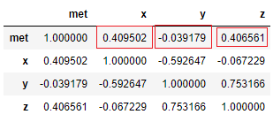
Pearson correlation matrix
MET(Metabolic Equivalent of Task) value has
no correlation with Y axis
average positive correlation with X and z axis

Slide 8

New insights
What the X Y Z columns are
The DiceFace Issue

Slide 9
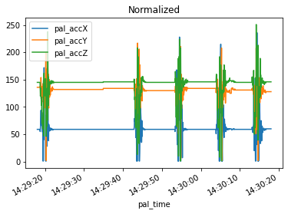
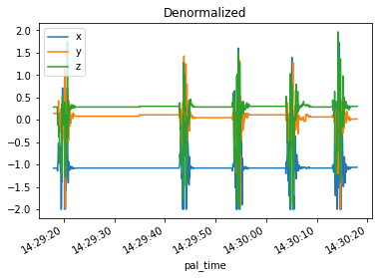
X, Y, Z columns
Scaled by formula: g = (value - 127) / 63
g: 9.81 m/s

Slide 10
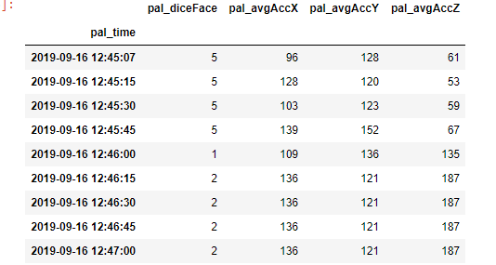
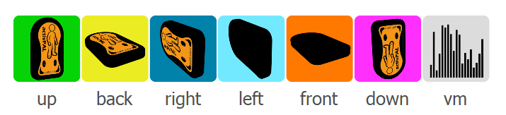
The DiceFace Issue
1 - up
2- back
3- right
4 - left
5 -front
6 – down

Slide 11
Current Issues we are facing
No DiceFace column in main dataset
Incorrect X, Y and Z values in main dataset

Slide 12
What are the goals for the remainder of this sprint?
Compile missing diceface values to main dataset
More (possible) features
Medio-lateral directions
The frequency peak of the power spectral density
Antero-posterior direction
Apply these features to our model to recognize activitie

Slide 13

Any questions?

